Slide 1
Northern University Bangladesh
Online Bird Rescue Platform
Present by
Mazharul Islam (04200101478)
Md. Sazzad Hossen(04190101294)
Supervised by
Sumaiya Akter
Lecturer
Department Of CSE
Northern University Bangladesh
‹#›

Slide 2
MENU
MENU
Introduction
Where’s the idea from?
Software used for the site
Used Programs
Demonstration
Capabilities of our project.
Future expansion
Limitation
Conclusion

Slide 3
Introduction
What is BD Birds ?
Birds Bd is a website or organization focused on birds and bird conservation in bangladesh.
Why do we need this ?
Birds Conservation
Fundraising
Awareness
Rescue
Education
Rehabilitation

Slide 4
Motivation
We care deeply about birds and their conservation.
We want to raise awareness about the importance of birds in our ecosystem.
We aim to provide resources for bird enthusiasts, conservationists, and scientists.
Our goal is to inspire people to take action and make a difference in bird conservation.

Slide 5

Problem Statement
There are no website for birds in Bangladesh.
Lack of public awareness about the importance of bird conservation.

Slide 6
Project Objective
01
02
03
04
Objective
Objective
Objective
Objective
Increase public awareness about bird conservation.
Provide resources for bird rescue and rehabilitation.
Encourage public engagement in bird conservation.
Increase fundraising efforts.
‹#›

Slide 7


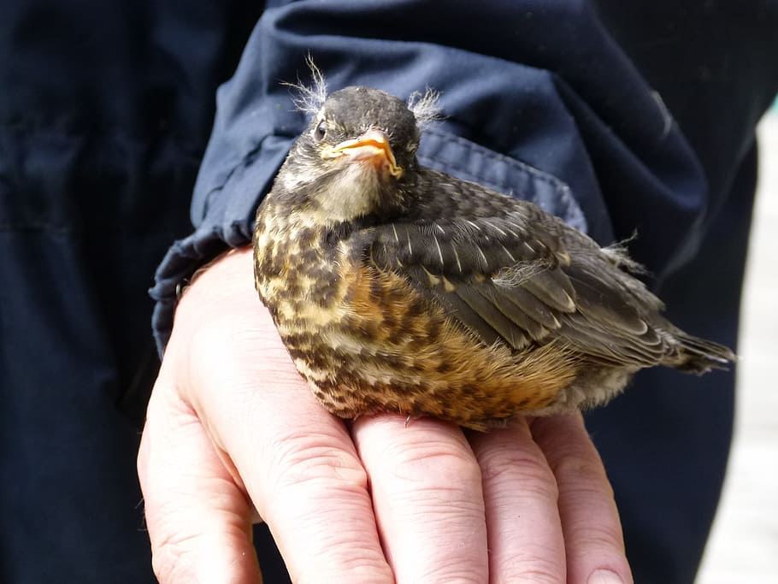

Main Function of the website
BD Birds works with these functions:
Fund Raising
Education
Rescue Birds
Live Support

Slide 8
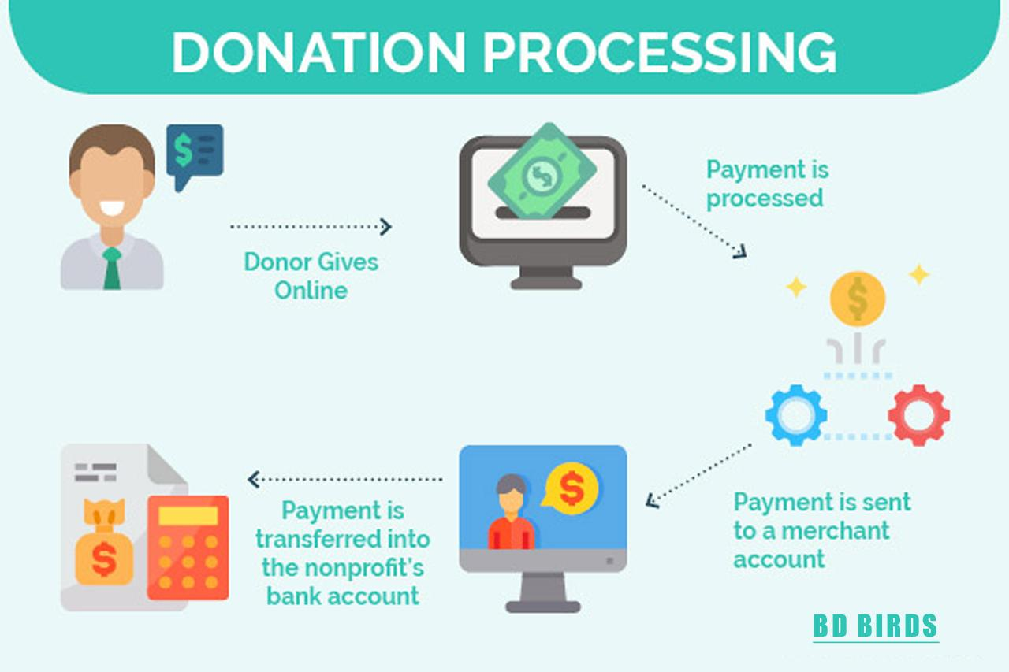
BD Birds donate System Process:

Slide 9


Software used for this site
Xampp
Vs code

Slide 10
Programs used:
For frontend:
Html5
Css 3
Bootstrap 5
For backend:
Php 8.2

Slide 11
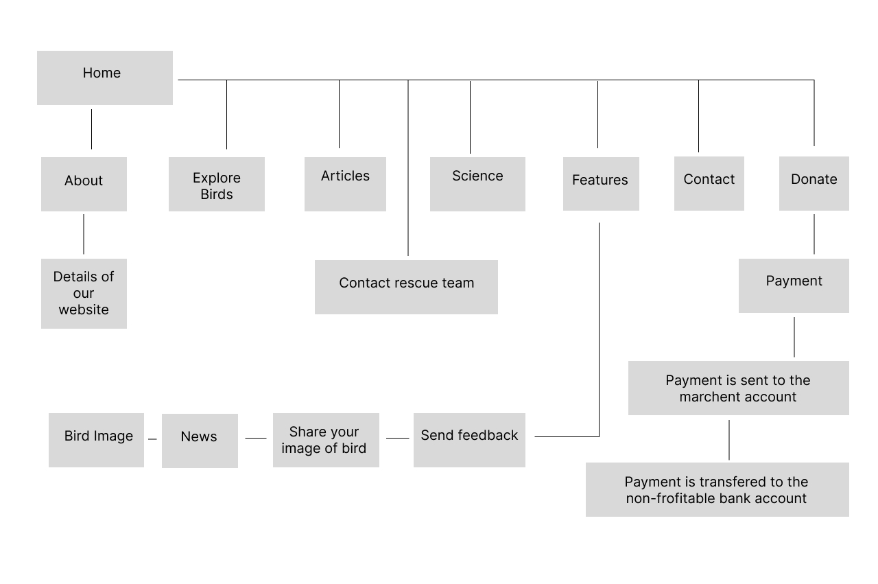
Project Diagram

Slide 12
Demonstration
Birds BD is a website dedicated to promoting bird conservation in Bangladesh.
We provide educational resources, public engagement options, and information on bird rescue and rehabilitation.
Our fundraising platform allows individuals to contribute to bird conservation efforts in Bangladesh.
We collaborate with other organizations and individuals to maximize the impact of our work.
Our goal is to make a real difference in protecting birds and their habitats in Bangladesh and create a community of people who care about their conservation.

Slide 13
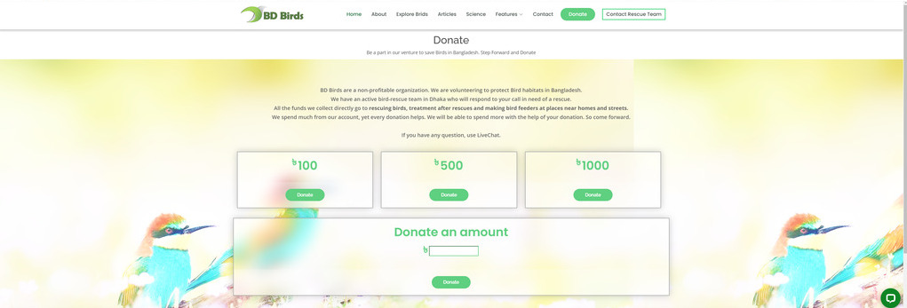
Capabilities
‹#›
Donate Feature

Slide 14
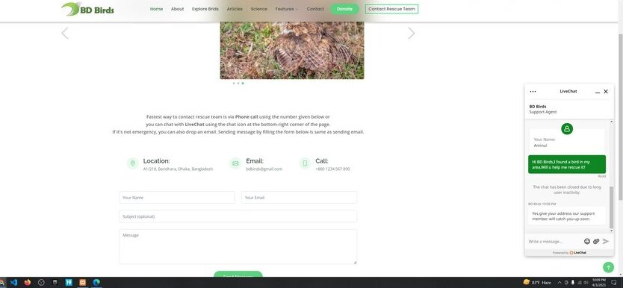
Capabilities
Live support feature

Slide 15



Future Expansion
Launch the science feature.
Provide Birds every information by their species section.
‹#›
Live payment option will be provided.

Slide 16

Limitation
Limitations
We run the site in localhost.
Our donate option is limited for now.We don't have any merchant account.
Our rescue team is short and support member is not enough.
We use a trial of 14 days for free live chat.

Slide 17
Conclusion
Birds BD is more than just a website - it is a platform for change and action. We are proud of the impact we have made so far, and we are committed to continuing to work towards our goals of promoting bird conservation in Bangladesh.

Slide 18

Any Question

Slide 19


